Slide 1
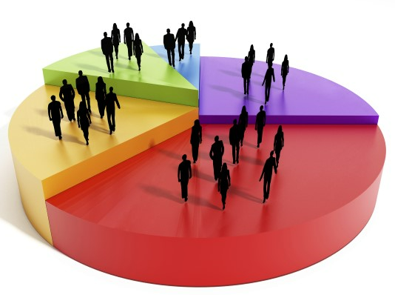
Capstone Project-4
Online Retail Customer Segmentation Unsupervised Machine Learning
By
Manas Nayan Mukherjee
Kunal RameshRao Kodarlikar

Slide 2
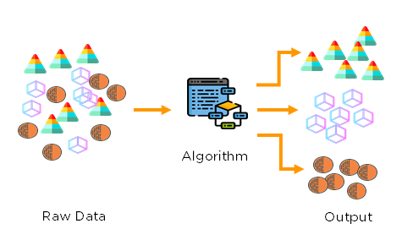
 Unsupervised Machine Learning 
What is Unsupervised Learning
As the name suggests, unsupervised learning is a machine learning technique in which models are not supervised using training dataset rather models are trained using unlabeled dataset and are allowed to act on that data without any supervision.
Goal
The goal of unsupervised learning is to find the underlying structure of dataset, group that data according to similarities, and represent that dataset in a compressed format.
Importance
Unsupervised learning is helpful for finding useful insights from the data. It is much similar as a human learns to think by their own experiences, which makes it closer to the real AI and works on unlabeled and uncategorized data which make unsupervised learning more important.
.
Explanation
Here, we have taken an unlabeled input data, which means it is not categorized and corresponding outputs are also not given. Now this unlabeled input data is fed to the machine learning model in order to train it. Firstly, it will interpret the raw data to find the hidden patterns from the data and then will apply suitable algorithms such as k-means clustering, decision tree, etc.
Once it applies the suitable algorithm, the algorithm divides the data objects into groups according to the similarities and difference between the objects.

Slide 3

 Problem Statement 
1. To identify major customer segments on a transational data set.
2. Data set contains all the transactions occurring between 1st december 2010 and 9th december 2011 for a UK-based and registered non-store online retail.
3. The company mainly sells unique all-occasion gifts.
4. Many customers of the company are wholesalers.

Slide 4
 Work flow segregation 
Data Description
Data Wrangling
Feature Engineering
Summary and Conclusion
Model Building
Exploratory data analysis (EDA)

Slide 5
 Data Description 
Total Rows= 541909 Total features=8
InvoiceNo: Invoice number. Nominal, a 6-digit integral number uniquely assigned to each transaction. If this code starts with letter 'c', it indicates a cancellation.
StockCode: Product (item) code. Nominal, a 5-digit integral number uniquely
assigned to each distinct product.
Description: Product (item) name. Nominal.
Quantity: The quantities of each product (item) per transaction. Numeric.
InvoiceDate: Invoice Date and time. Numeric, the day and time when each
transaction was generated.
UnitPrice: Unit price. Numeric, Product price per unit in sterling.
CustomerID: Customer number. Nominal, a 5-digit integral number uniquely
assigned to each customer.
Country: Country name. Nominal, the name of the country where each customer resides.

Slide 6
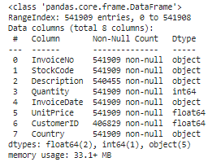

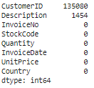
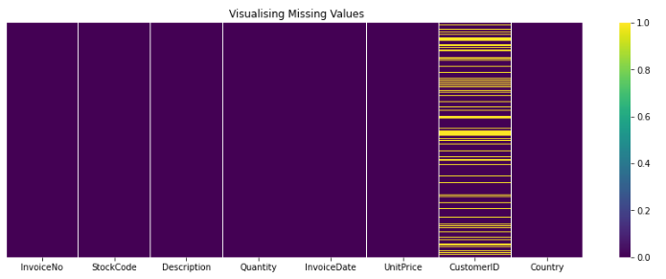
 Data Wrangling 
Information of the data
Null values
Observations
1. Invoicedate to datetime.
2. If InvoiceNo starts with C means it's a cancellation.
3. Shape of data after dropping entries=397884

Slide 7
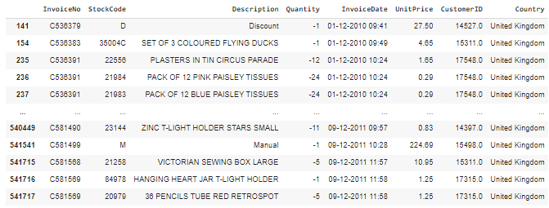
 Data Wrangling 
Invoice No starting with C has negative entries in the quantity column which indicates cancellations.

Slide 8

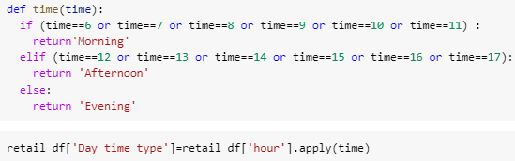
 Feature Engineering 
Changed the datatype of Invoice Date column into datetime

Slide 9
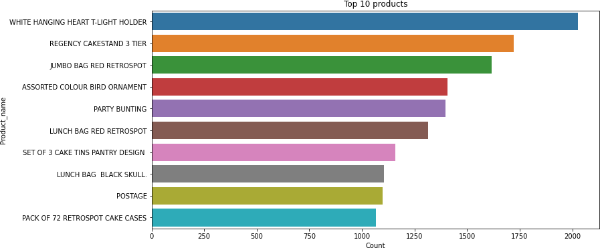
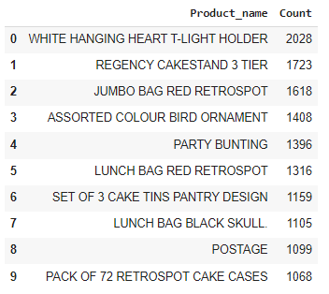
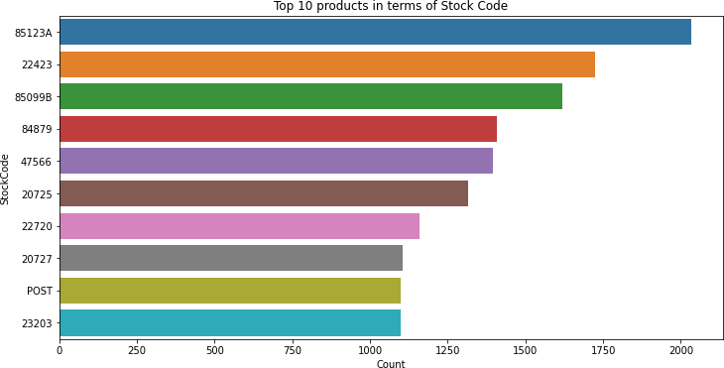
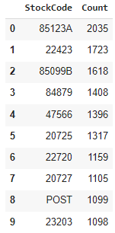
Exploratory Data Analysis
Top 10 products (description wise)
White Hanging Heart T- Light Holder is the highest selling product almost 2018 units were sold.
Top 10 products (stock code wise)
StockCode-85123A is the first highest selling product.
StockCode-22423 is the 2nd highest selling product.

Slide 10
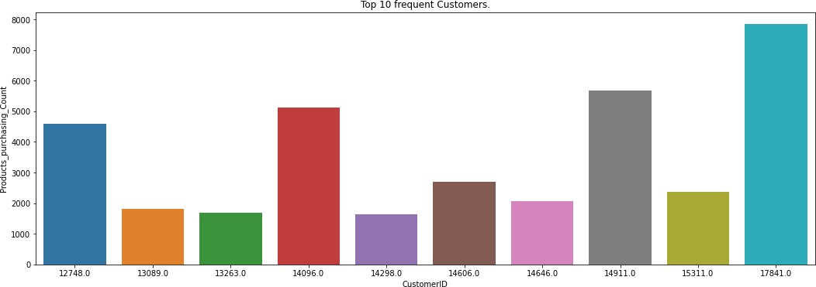
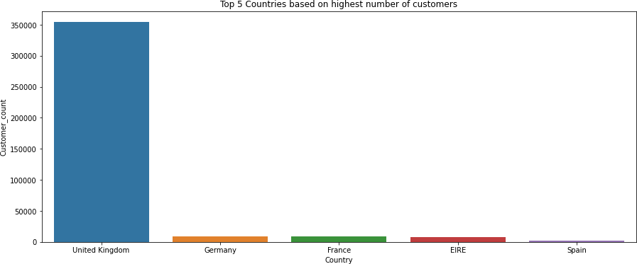
 Exploratory Data Analysis 
Top 10 customers
Customer ID-17841 had purchased highest number of products.
Customer ID-14911 is the 2nd highest customer who purchased the most the products.
Top 5 countries (based on number of customers)
UK has highest number of customers.
Germany, France and Ireland has almost equal number of customers.

Slide 11
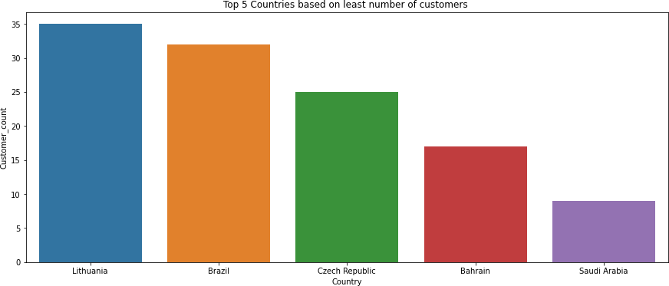
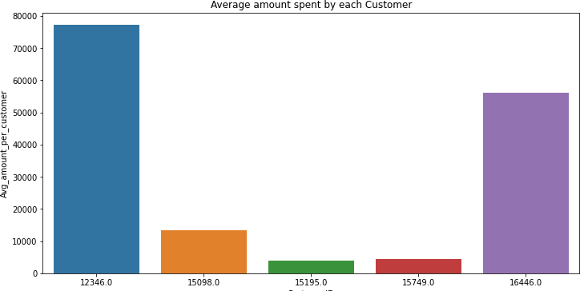
 Exploratory Data Analysis 
Top 5 countries (based on Least number of customers)
There are very less customers from Saudi Arabia.
Bahrain is the 2nd country having least number of customers.
Top 10 customers(average amount spent by customers)
77183 (Pounds) is the highest average amount spent by the Customer ID-12346.
56157 (Pounds) is the 2nd highest average amount spent by the Customer ID-16446.

Slide 12
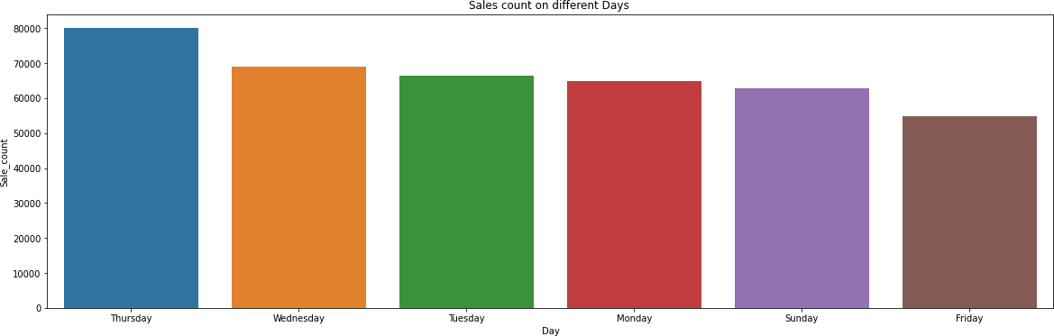
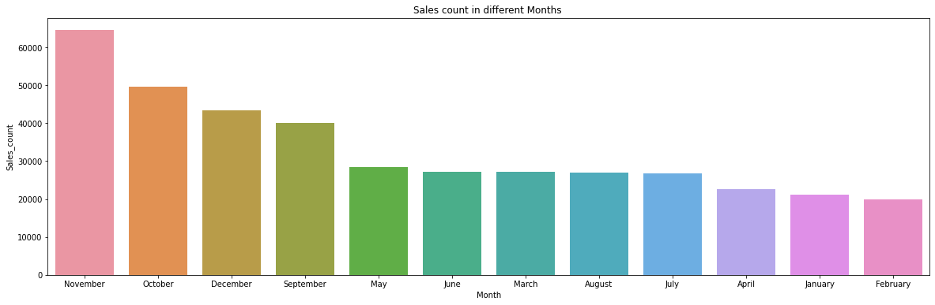
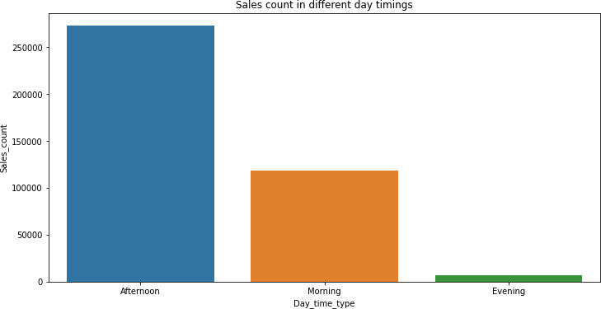
Exploratory Data Analysis
Sales On Thursdays are very high.
Sales On Fridays are very less.
Most of the sales happened in November month.
February Month had least sales.
Most of the sales happens in the afternoon.
Least sales happens in the evening.

Slide 13
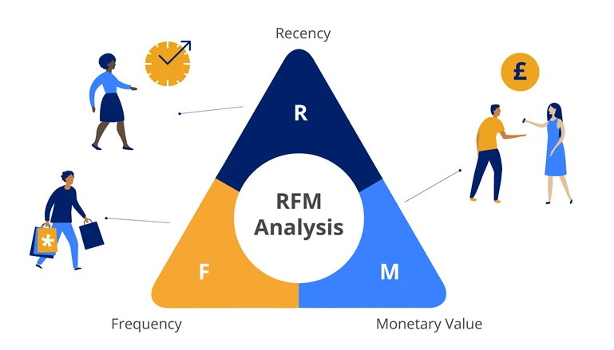
 Model Building 
RFM Model Analysis
What is RFM?
RFM is a method used to analyze customer value. It stands for Recency, Frequency and Monetary.
Recency: How recently did the customer visit our website or how recently did a
customer purchase?
Frequency: How often do they visit or how often do they purchase?
Monetary: How much revenue we get from their visit or how much do they spend when they purchase?
Why it is Needed?
RFM Analysis is a marketing framework that is used to understand and analyze customer behavior based on three factors Recency, Frequency, and Monetary.
The RFM Analysis will help the businesses to segment their customer base into different homogeneous groups so that they can engage with each group with different targeted marketing strategies.

Slide 14
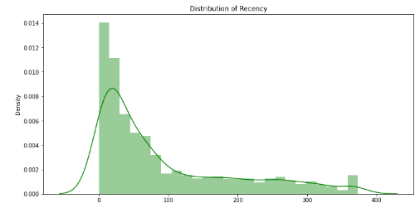
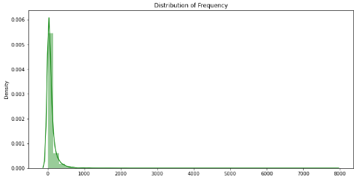
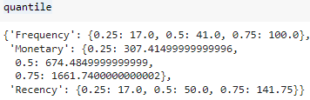
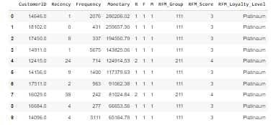
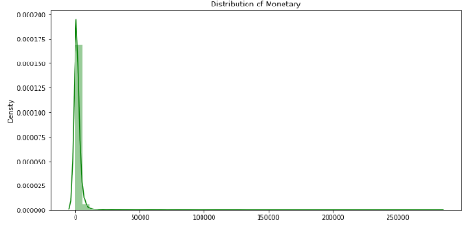
 Model building 
RFM Model Analysis
Recency = Latest Date - Last Invoice Data.
Frequency = Count of invoice no. of transaction(s).
Monetary = Sum of Total Amount for each customer.
Recency
Frequency
Monetary

Slide 15
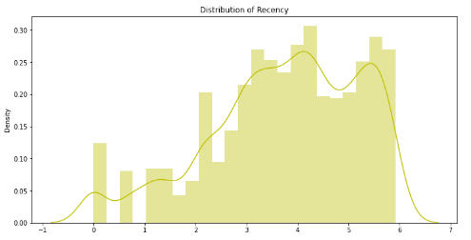
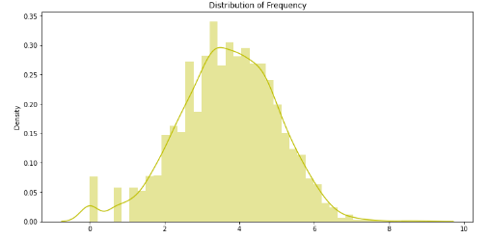
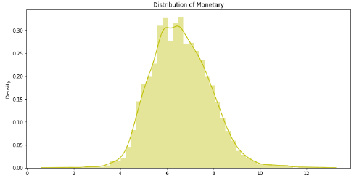
 Model Building 
RFM Model Analysis
Log transformation on Frequency, Recency and Monetary
Recency
Frequency
Monetary

Slide 16
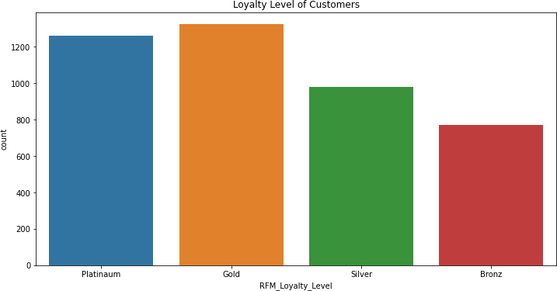

 Model Building 
RFM Model Analysis
Using RFM Model analysis only 4 clusters have been created which are Platinum, Gold, Silver and Bronze

Slide 17
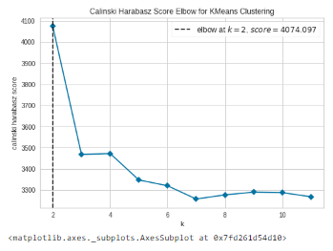
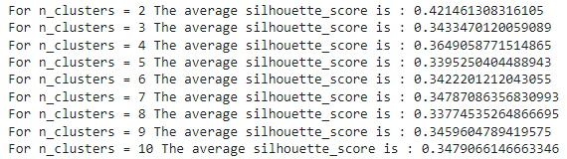
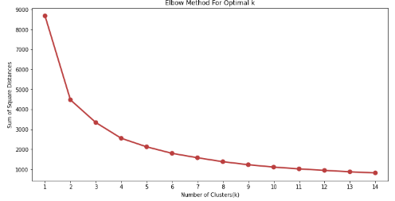
 Model Building 
K-means Clustering ( Recency and Monetary)
Finding the Optimal value of cluster using Elbow method and Silhouette Score

Slide 18
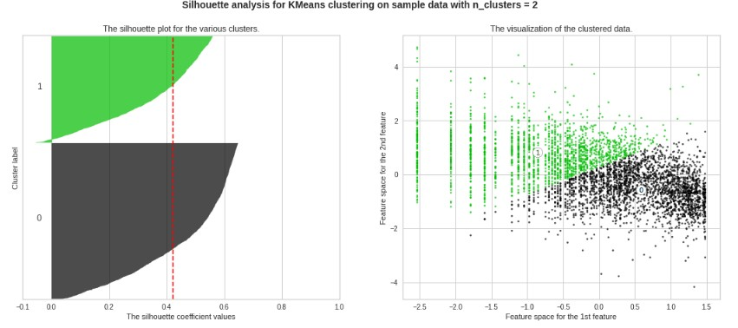
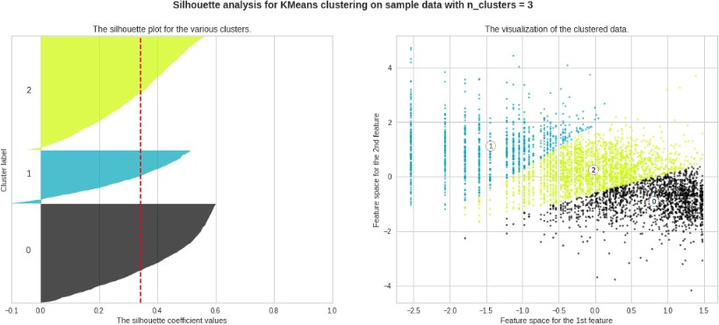
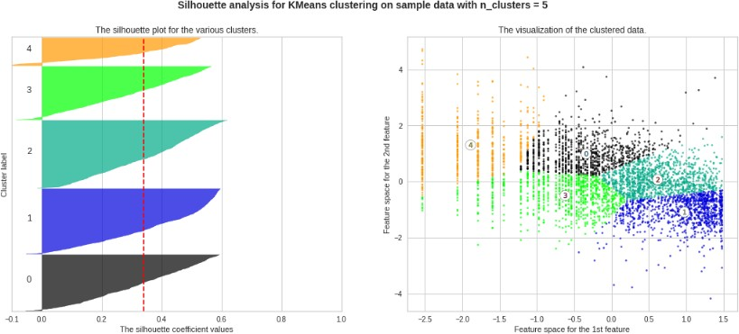
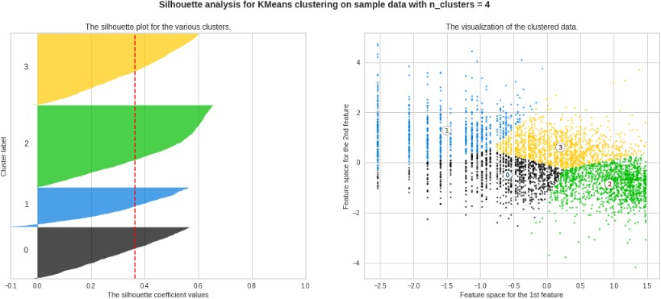
 Model Building 
K-means Clustering ( Recency and Monetary)

Slide 19
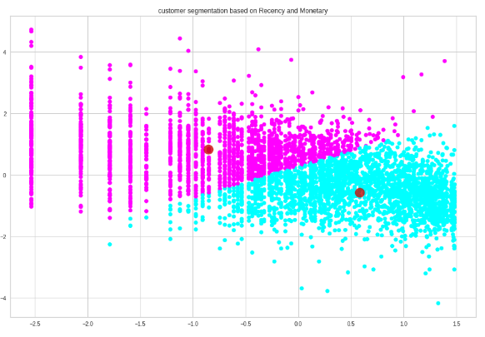
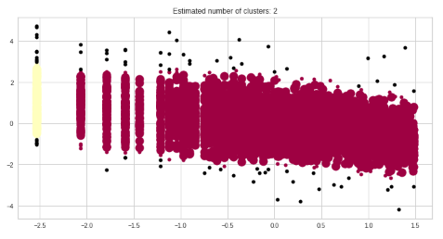
 Model Building 
K-means Clustering ( Recency and Monetary)
DBSCAN Algorithm ( Recency and Monetary

Slide 20
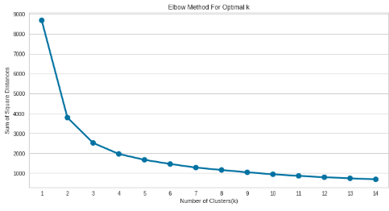
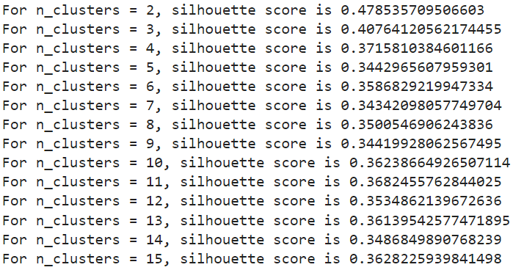
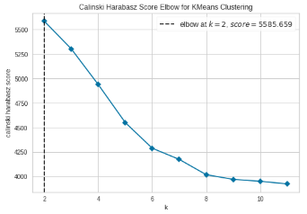
 Model Building 
K-means Clustering ( Frequency and Monetary)
Finding the Optimal value of cluster using Elbow method and Silhouette Score

Slide 21
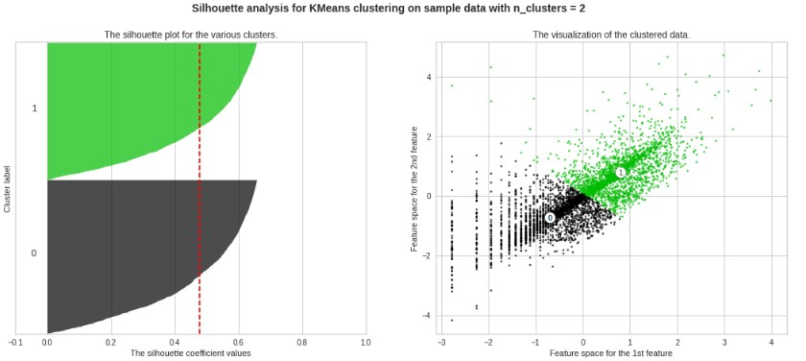
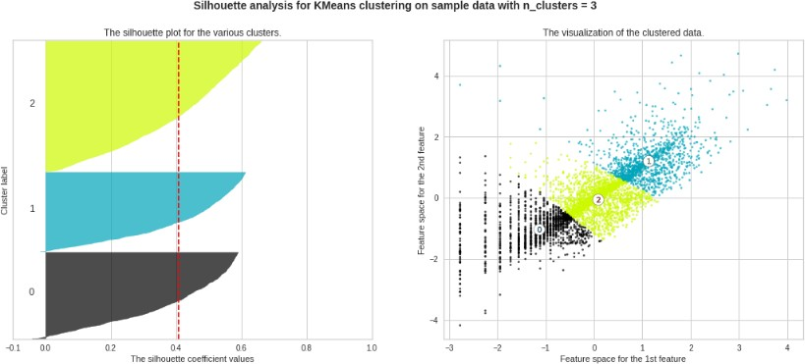
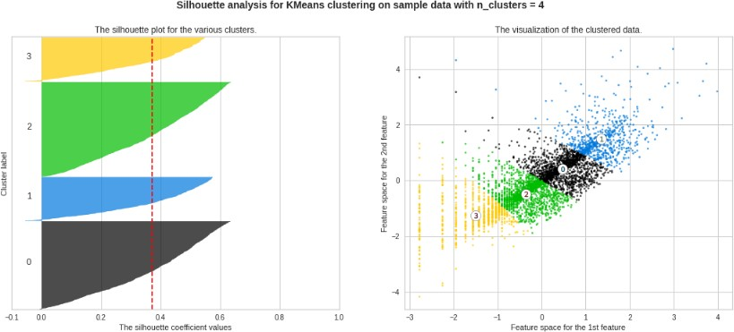
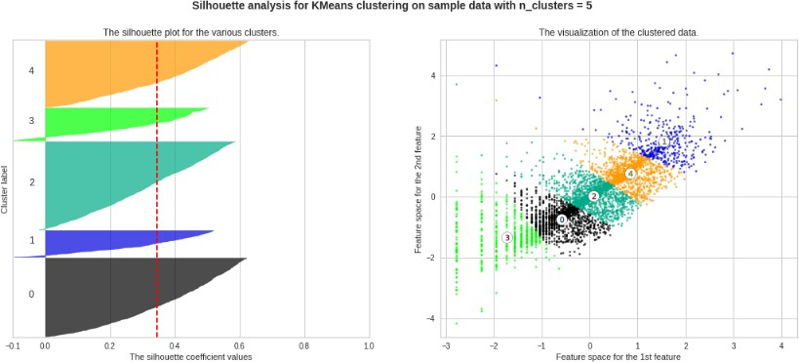
 Model Building 
K-means Clustering ( Frequency and Monetary)

Slide 22
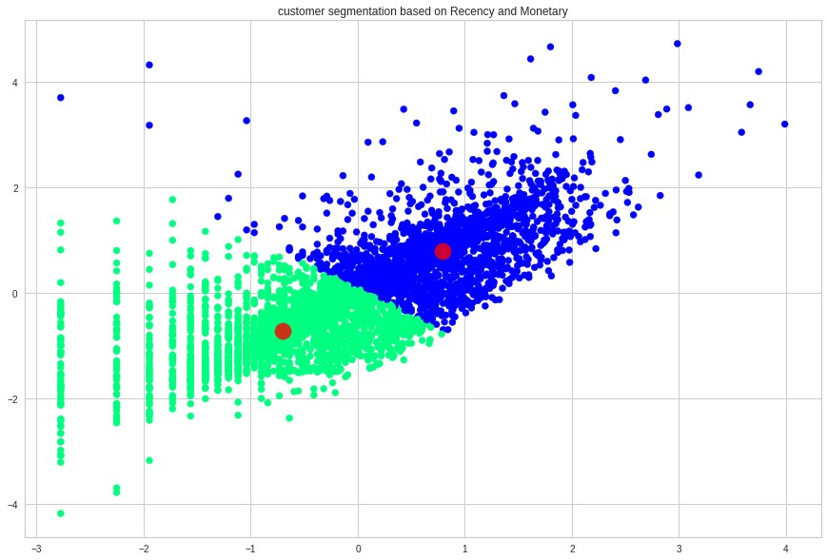
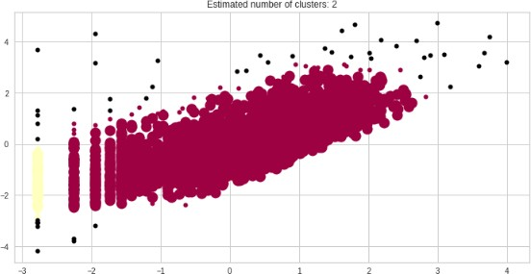
 Model Building 
K-means Clustering ( Frequency and Monetary)
DBSCAN Algorithm ( Frequency and Monetary

Slide 23
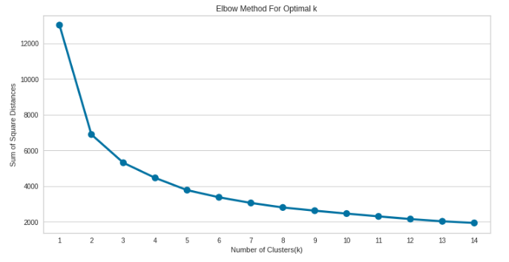
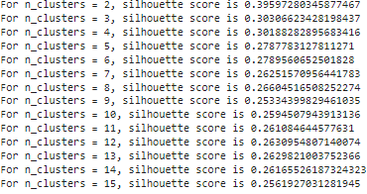
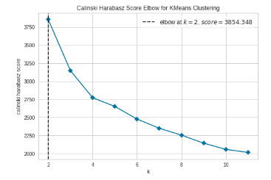
 Model Building 
K-means Clustering ( Recency, Frequency and Monetary)
Finding the Optimal value of cluster using Elbow method and Silhouette Score

Slide 24
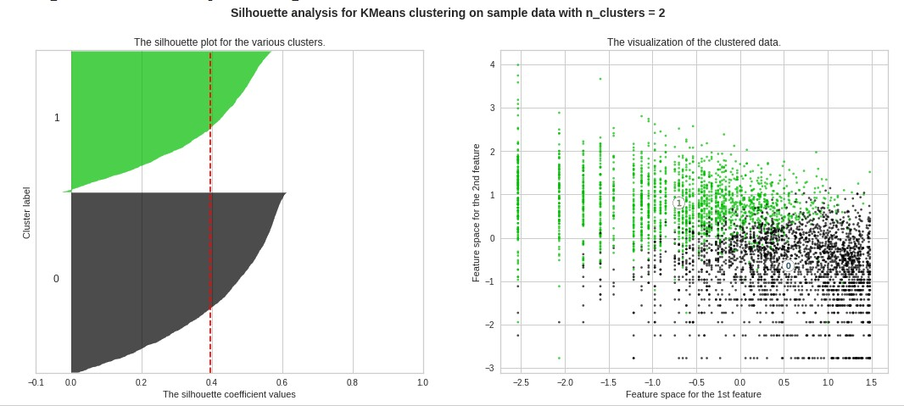


 Model Building 
K-means Clustering ( Recency, Frequency and Monetary)

Slide 25


 Model Building 
K-means Clustering ( Recency, Frequency and Monetary)
DBSCAN Algorithm ( Recency, Frequency and Monetary

Slide 26


 Model Building 
Hierarchical Clustering (Recency, Frequency and Monetary)
Optimal Number of clusters using Dendogram.(Optimal Clusters=2)

Slide 27

 Summary and Conclusion 
Firstly we did clustering based on RFM analysis. We had 4 clusters/Segmentation of customers based on RFM score
Observations
1. Platinum customers=1263 ( less recency but high frequency and heavy spendings).
2. Gold customers=1324 (good recency,frequency and monetary).
3. Silver customers=981(high recency, low frequency and low spendings).
4. Bronze customers=770 (very high recency but very less frequency and spendings).

Slide 28

 Summary and Conclusion 
Later we implemented the machine learning algorithms to cluster the customers

Slide 29

 Summary and Conclusion 
Observations
1. Above clustering is done with recency, frequency and monetary data (K means Clustering) as all 3 together will provide more information.
2. Cluster 0 has high recency rate but very low frequency and monetary. Cluster 0 contains 2414 customers.
3. Cluster 1 has low recency rate but they are frequent buyers and spends very high money than other customers as mean monetary value is very high.Thus generates more revenue to the retail business.
4. With this, we are done. Also, we can use more robust analysis for the clustering, using not only RFM but other metrics such as demographics or product features.

Slide 30


